Slide 1
Cryptography and Network Security
MD5

Slide 2
Session Meta Data
Author | Dr T Sree Sharmila
Reviewer
Version Number | 1.0
Release Date | 24 July 2018

Slide 3
Revision History
Revision Date | Details | Version no.
 |  | 1.0

Slide 4
Agenda
Birthday attack
Hash function properties
Hash algorithm
MD5
MD4
Strength of MD5
Summary
Test your understanding
References

Slide 5
Birthday Attacks
might think a 64-bit hash is secure
but by Birthday Paradox is not
birthday attack works thus:
opponent generates 2^{m/2} variations of a valid message all with essentially the same meaning
opponent also generates 2^{m/2} variations of a desired fraudulent message
two sets of messages are compared to find pair with same hash (probability > 0.5 by birthday paradox)
have user sign the valid message, then substitute the forgery which will have a valid signature
conclusion is that need to use larger MACs
Notes:
The Birthday Attack exploits the birthday paradox – the chance that in a group of people two will share the same birthday – only 23 people are needed for a Pr>0.5 of this. Can generalize the problem to one wanting a matching pair from any two sets, and show need 2^{m/2} in each to get a matching m-bit hash.
Note that creating many message variants is relatively easy, either by rewording or just varying the amount of white-space in the message.

Slide 6
Agenda
Birthday attack
Hash function properties
Hash algorithm
MD5
MD4
Strength of MD5
Summary
Test your understanding
References

Slide 7
Hash Function Properties
a Hash Function produces a fingerprint of some file/message/data
h = H(M)
condenses a variable-length message M
to a fixed-sized fingerprint
assumed to be public

Slide 8
Block Ciphers as Hash Functions
can use block ciphers as hash functions
using H₀=0 and zero-pad of final block
compute: H_{i} = E_{Mi} [H_{i-1}]
and use final block as the hash value
similar to CBC but without a key
resulting hash is too small (64-bit)
both due to direct birthday attack
and to “meet-in-the-middle” attack
other variants also susceptible to attack

Slide 9
Agenda
Birthday attack
Hash function properties
Hash algorithm
MD5
MD4
Strength of MD5
Summary
Test your understanding
References

Slide 10
Hash Algorithms
similarities in the evolution of hash functions & block ciphers
increasing power of brute-force attacks
leading to evolution in algorithms
from DES to AES in block ciphers
from MD4 & MD5 to SHA-1 & RIPEMD-160 in hash algorithms
likewise tend to use common iterative structure as do block ciphers

Slide 11
Agenda
Birthday attack
Hash function properties
Hash algorithm
MD5
MD4
Strength of MD5
Summary
Test your understanding
References

Slide 12
MD5
designed by Ronald Rivest (the “R” in RSA)
latest in a series of MD2, MD4
produces a 128-bit hash value
until recently was the most widely used hash algorithm
in recent times have both brute-force & cryptanalytic concerns
specified as Internet standard RFC1321
Notes:
MD5 is the current, and very widely used, member of Rivest’s family of hash functions.

Slide 13
MD5 Overview
pad message so its length is 448 mod 512
append a 64-bit length value to message
initialise 4-word (128-bit) MD buffer (A,B,C,D)
process message in 16-word (512-bit) blocks:
using 4 rounds of 16 bit operations on message block & buffer
add output to buffer input to form new buffer value
output hash value is the final buffer value
Notes:
The padded message is broken into 512-bit blocks, processed along with the buffer value using 4 rounds, and the result added to the input buffer to make the new buffer value. Repeat till run out of message, and use final buffer value as hash. nb. due to padding always have a full final block (with length in it).

Slide 14
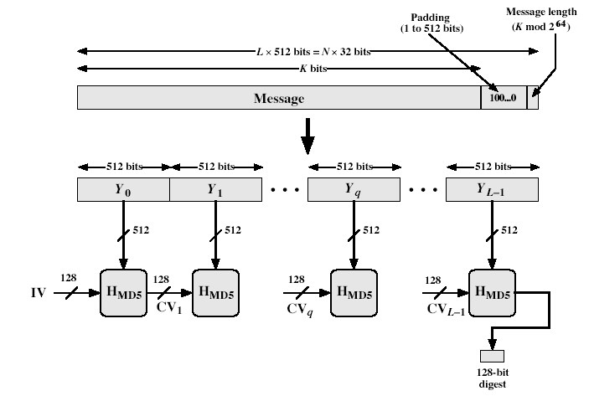
MD5 Overview
Notes:
Stallings Fig 12-1.

Slide 15
MD5 Compression Function
each round has 16 steps of the form:
a = b+((a+g(b,c,d)+X[k]+T[i])<<<s)
a,b,c,d refer to the 4 words of the buffer, but used in varying permutations
note this updates 1 word only of the buffer
after 16 steps each word is updated 4 times
where g(b,c,d) is a different nonlinear function in each round (F,G,H,I)
T[i] is a constant value derived from sin
Notes:
Each round mixes the buffer input with the next "word" of the message in a complex, non-linear manner. A different non-linear function is used in each of the 4 rounds (but the same function for all 16 steps in a round). The 4 buffer words (a,b,c,d) are rotated from step to step so all are used and updated. g is one of the primitive functions F,G,H,I for the 4 rounds respectively. X[k] is the kth 32-bit word in the current message block. T[i] is the ith entry in the matrix of constants T. The addition of varying constants T and the use of different shifts helps ensure it is extremely difficult to compute collisions.

Slide 16
MD5 Compression Function
Each round mixes the buffer input with the next "word" of the message in a complex, non-linear manner.
A different non-linear function is used in each of the 4 rounds (but the same function for all 16 steps in a round).
The 4 buffer words (a,b,c,d) are rotated from step to step so all are used and updated.
g is one of the primitive functions F,G,H,I for the 4 rounds respectively.
X[k] is the kth 32-bit word in the current message block.
T[i] is the ith entry in the matrix of constants T.
The addition of varying constants T and the use of different shifts helps ensure it is extremely difficult to compute collisions.
Notes:
Each round mixes the buffer input with the next "word" of the message in a complex, non-linear manner. A different non-linear function is used in each of the 4 rounds (but the same function for all 16 steps in a round). The 4 buffer words (a,b,c,d) are rotated from step to step so all are used and updated. g is one of the primitive functions F,G,H,I for the 4 rounds respectively. X[k] is the kth 32-bit word in the current message block. T[i] is the ith entry in the matrix of constants T. The addition of varying constants T and the use of different shifts helps ensure it is extremely difficult to compute collisions.

Slide 17
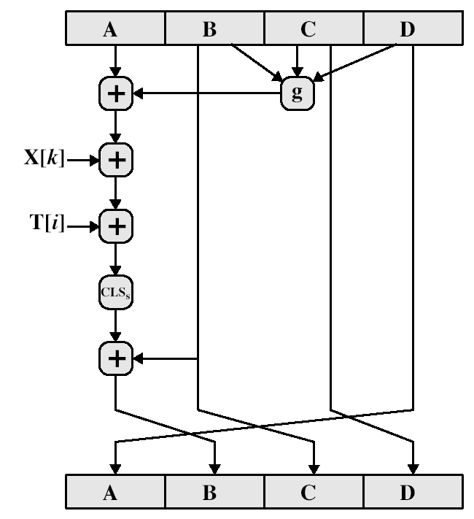
MD5 Compression Function
Notes:
Stallings Fig 12-3.

Slide 18
Agenda
Birthday attack
Hash function properties
Hash algorithm
MD5
MD4
Strength of MD5
Summary
Test your understanding
References

Slide 19
MD4
precursor to MD5
also produces a 128-bit hash of message
has 3 rounds of 16 steps versus 4 in MD5
design goals:
collision resistant (hard to find collisions)
direct security (no dependence on "hard" problems)
fast, simple, compact
favors little-endian systems (eg PCs)
Notes:
MD4 is the precursor to MD5, and was widely used. It uses 3 instead of 4 rounds, and the round functions are a little simpler. In creating MD5 Rivest aimed to strengthen the algorithms by introducing the extra round, and varying the constants used.

Slide 20
Agenda
Birthday attack
Hash function properties
Hash algorithm
MD5
MD4
Strength of MD5
Summary
Test your understanding
References

Slide 21
Strength of MD5
MD5 hash is dependent on all message bits
Rivest claims security is good as can be
known attacks are:
Berson 92 attacked any 1 round using differential cryptanalysis (but can’t extend)
Boer & Bosselaers 93 found a pseudo collision (again unable to extend)
Dobbertin 96 created collisions on MD compression function (but initial constants prevent exploit)
conclusion is that MD5 looks vulnerable soon
Notes:
Some progress has been made analysing MD5, which along with the hash size of 128-bits means its starting to look too small. Hence interest in hash functions that create larger hashes.

Slide 22
Agenda
Birthday attack
Hash function properties
Hash algorithm
MD5
MD4
Strength of MD5
Summary
Test your understanding
References

Slide 23
Summary
have discussed:
digital signatures
ElGamal & Schnorr signature schemes
digital signature algorithm and standard
Notes:
Chapter 13 summary

Slide 24
Agenda
Birthday attack
Hash function properties
Hash algorithm
MD5
MD4
Strength of MD5
Summary
Test your understanding
References

Slide 25
Test your understanding
What is birthday attack?
State the strength of MD5.
Explain in detail MD5.

Slide 26
Agenda
Birthday attack
Hash function properties
Hash algorithm
MD5
MD4
Strength of MD5
Summary
Test your understanding
References

Slide 27
References
1. William Stallings, Cryptography and Network Security, 6th Edition, Pearson Education, March 2013.
2. Charlie Kaufman, Radia Perlman and Mike Speciner, “Network Security”, Prentice Hall of India, 2002.

